Slide 1

Telecommunication Customer Churn Prediction
BU.330.780.52.SP19 Data Science and Business Intelligence – Final Group Project
Group 6: Lok Tin Kevin Chan, Hanchi Gu, Xinyi Li, Sihan Niu, Yuzi Wang, Lulu Xing

Slide 2
Agenda
1. Business Understanding
2. Data Understanding & Visualization
3. Modelling
4. Evaluation
5. Deployment

Slide 3

Business Understanding
Telecommunication Industry
Disappearance of the differentiability of product and service
Customer lose Loyalty and becomes indifferent between companies
Forces many telecommunication company to retain their existing customer or engage in price wars

Slide 4
Business Understanding
On average the cost to acquire a new customer is much more expensive to retain a customer
Identify potential churning customer and target them with a new competitive offers/bundles or other marketing campaign
Limited budget and get most effective return on investment
Objective
Predict if a customer will churn
Gain some understanding to why customer churn

Slide 5
Data Understanding & Visualization
Date Set from Kaggle: Teleco Customer Churn
The dataset contains 7,043 client information and 20 variables:
16 Categorical Variable
3 Continuous Variable
1 Target Variable – Churn
Attributes:
Services that each customer has signed up for
Customer account information
Demographic information about customer
Target variable: whether customer has left within the last month

Slide 6
Data Understanding & Visualization
11 missing values and all of them belong to missing total charges column (7043 observations)
Further observation
tenure = 0, meaning that these customers are most likely in their first month and thus have not been billed
Conclusion
None of them churned, not special follow other observations
Remove them from our dataset

Slide 7
Data Understanding & Visualization
Data Preparation
“No”, “No internet Service” or “No Phone Service” the same
Convert to be the same Tenure, monthly charge and total charges are on different scales
Standardized them to reduce the bias that might result from the difference in scale.
Hold-out validation
Split our 7032 observation into a training set (80%) and testing set (20%)

Slide 8
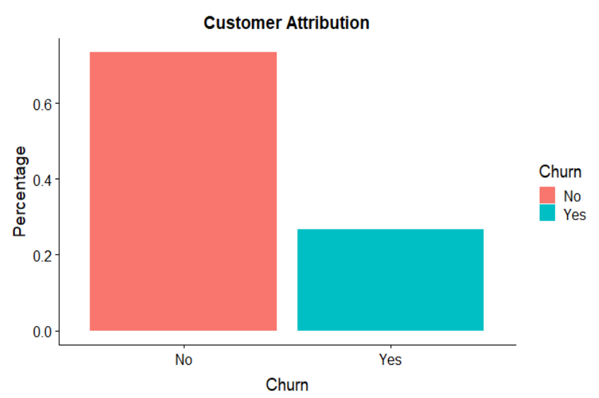
Data Understanding & Visualization

Slide 9
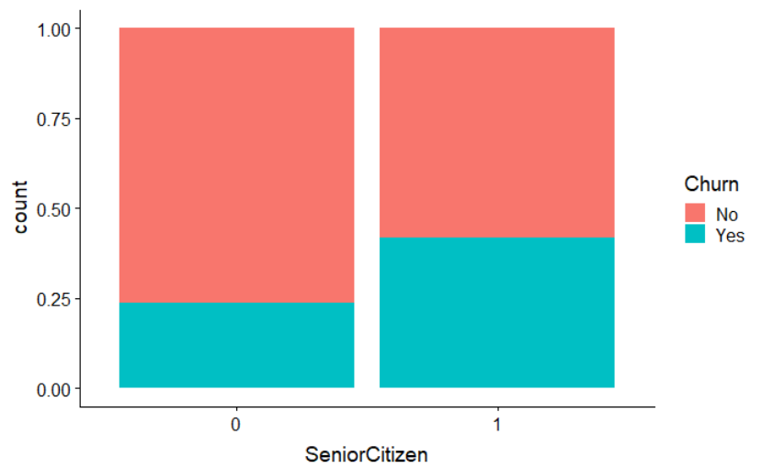
Data Understanding & Visualization
Senior Citizen has higher churn percentage

Slide 10
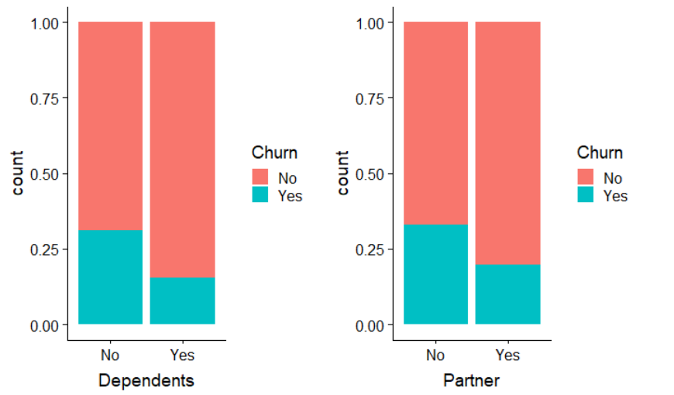
Data Understanding & Visualization
Customer with dependents or partners tend to have lower churn rate

Slide 11
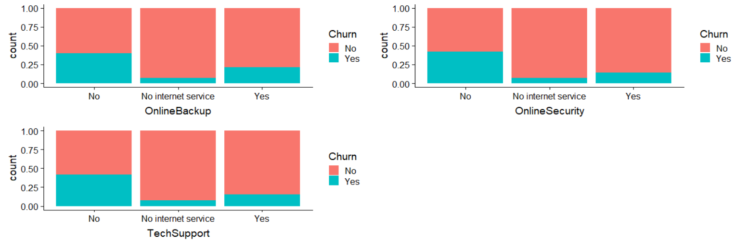
Data Understanding & Visualization
Customer with no online security, online backup or tech support have higher churn rate

Slide 12
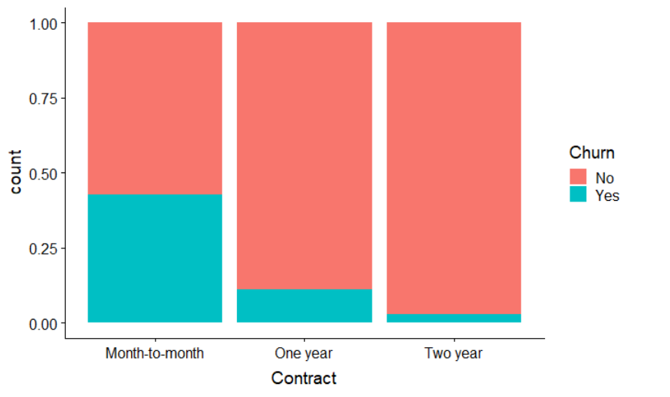
Data Understanding & Visualization
Customer with monthly subscription are more likely to churn compared to longer contracts

Slide 13
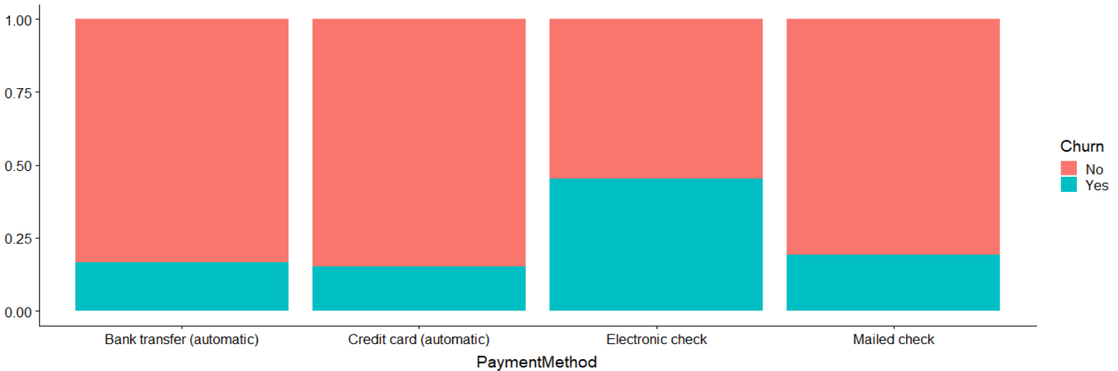
Data Understanding & Visualization
Customer with electronic check payment method tend to churn more compared to other options

Slide 14
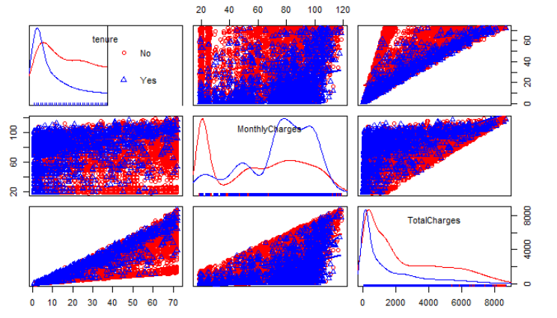
Data Understanding & Visualization
1. Recent client is more likely to churn
2. Clients with higher monthly charges are more likely to churn

Slide 15
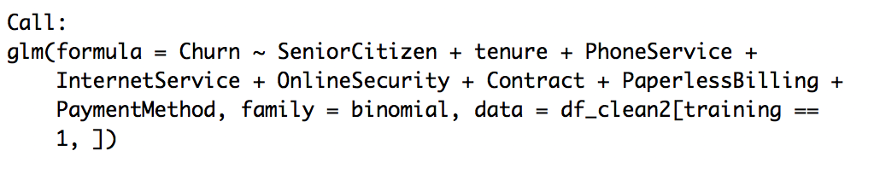
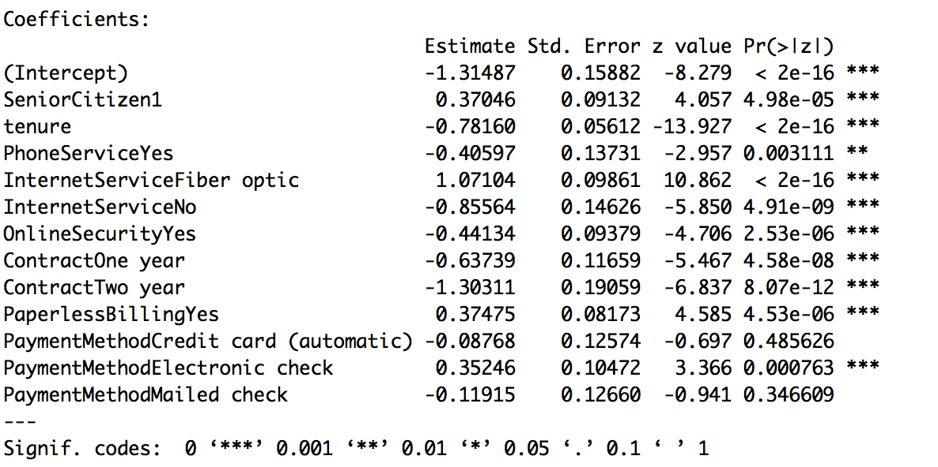
Modeling – Logit Model

Slide 16
Modeling – Logit Model
Among the nine variables we select to build the best GLM model, contract, internet service, and tenure have great impact on churn rate.
Customer with longer contract tends to be more viscid.
Customer with fiber optic service has higher churn rate than that with DSL service.
Recent clients are more likely to churn.

Slide 17
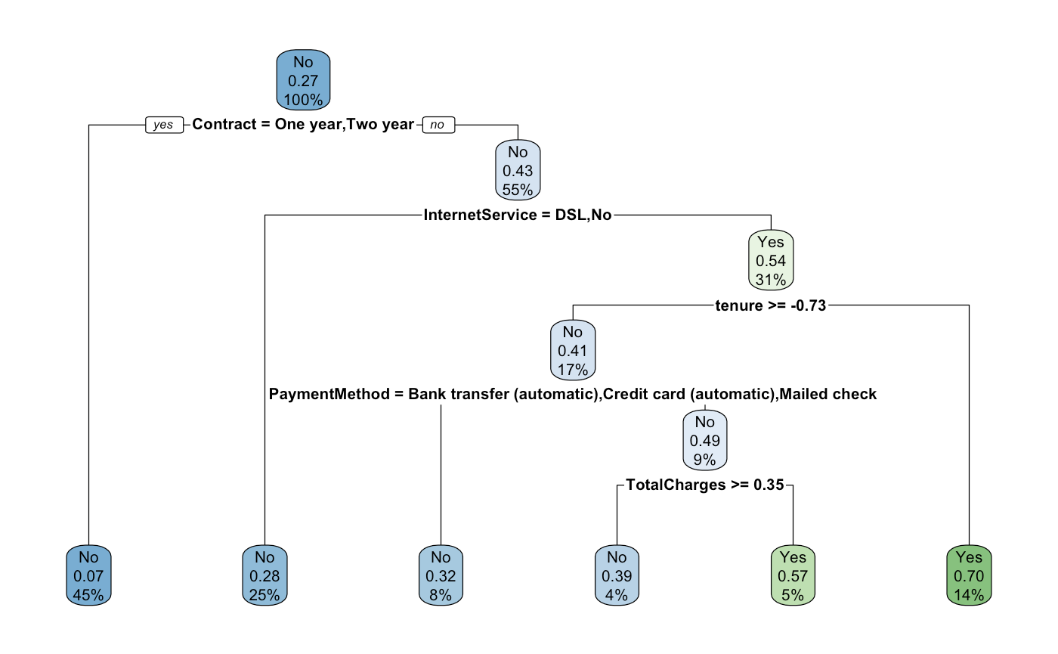
Modeling – Decision Tree Model

Slide 18
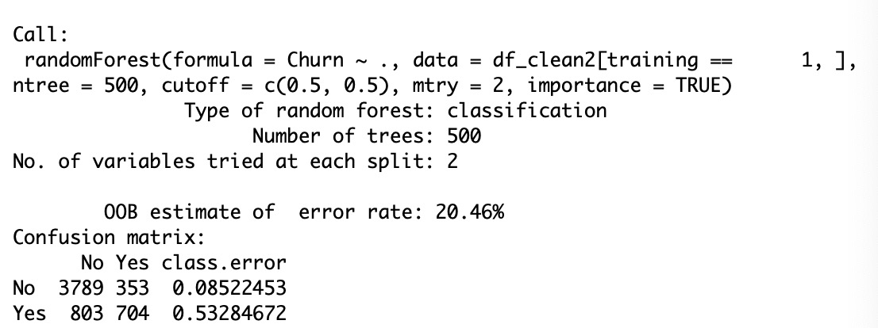
Modeling – Random Forest Model
Advantage: Useful to reduce the variance of classification tree.
Disadvantage: Black Box algorithms, hard to interpret.

Slide 19
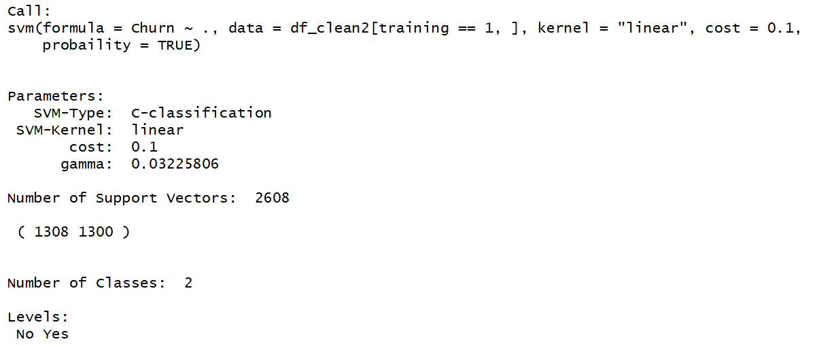
Modeling – SVM (“Linear”) Model
Disadvantage: Computationally Expensive.

Slide 20
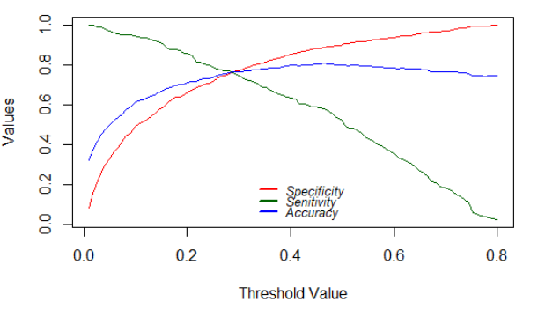
Modeling – Threshold Analysis

Slide 21
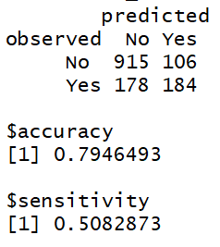
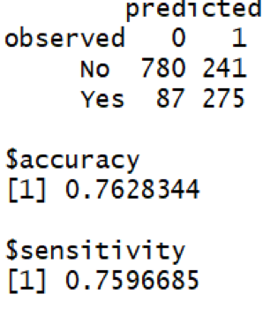
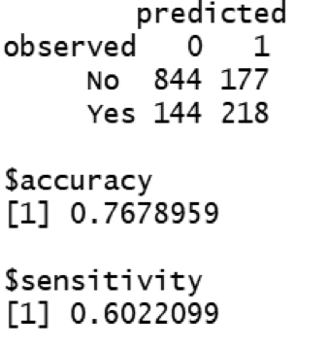
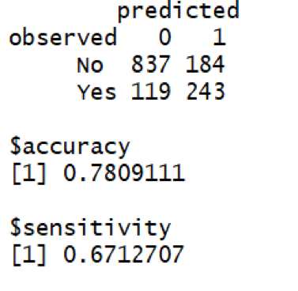
Evaluation – Confusion Matrix
Logistic Regression | Decision Tree | Random Forest | SVM

Slide 22
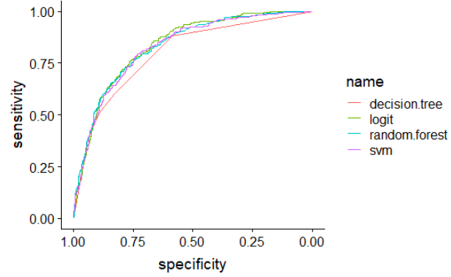
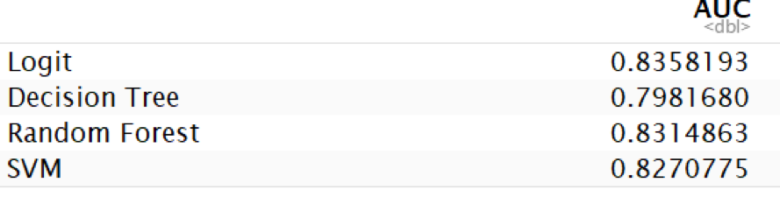
Evaluation – ROC

Slide 23
Deployment
Purpose of the model building:
create a mode client can use to target existing customers
Measure the impact of targeting:
Compare the customer lifetime value of targeted customer before and after the campaign
See if the return on marketing investment (ROMI) yields positive value

Slide 24
Deployment
Tenure
Retain long-tenure customers by providing welfares
free on-site service, premium for contract renewal
Builds a close communication relationship with customers
sending letter, special offers, emails and follow-ups
Contract
Customers with two-year contract are more likely to retain current service
Attach more preferential policy on two-year contract
reduction in total charges
bundle service with partner firms to provide extra benefit for customers

Slide 25
Deployment – Risk Analysis
Information safety
selling and buying personal information
using customer’s data without permission
avoid leakage of information and use it in a responsible way
Employees fail to put suggestions into practice
employees keep thinking in the old way
keep implementing the old strategy to customers
Mitigation: build a communication system to remind employees of the necessity to carry out new loyalty system

